Slide 1
Spatial-Temporal Analysis of Vegetation Cover Change (LULC) in Diamer using Geospatial Techniques and Supervised Classification.
Mehtab Ali
alimehtab0003@gamil.com
Supervisor: Hafiz u din
Course: Data Sciences And Machine Learning

Slide 2
Problem Background
Diamer District, a mountainous region of Gilgit-Baltistan, is environmentally fragile and highly sensitive to land-use and vegetation changes.
Changes in LULC directly affect hydrology, ecosystem stability, disaster risk, and sustainable development in the Upper Indus Basin.
Accurate LULC mapping is difficult due to steep terrain, spectral heterogeneity, and mixed pixels, where traditional classifiers perform poorly.
Advanced machine learning techniques are therefore required to reliably monitor LULC changes in such complex mountainous environments.

Slide 3
Problem Statement
Accurate LULC mapping in Diamer District is difficult due to complex mountainous terrain, spectral heterogeneity, and mixed pixels in satellite imagery.
Traditional classification methods fail to reliably model non-linear land-cover patterns in heterogeneous alpine environments.
There is limited comparative evaluation of advanced ML models (SVM, Random Forest, XGBoost) for LULC classification in high-altitude regions of Gilgit-Baltistan.
The lack of high-accuracy LULC information restricts effective environmental monitoring, land-use planning, and sustainable development decisions.

Slide 4
What are the Project Goals
To develop an accurate LULC classification framework for Diamer District using multispectral satellite imagery and supervised machine learning techniques.
To compare the performance of SVM, Random Forest, and XGBoost in classifying complex mountainous land-cover types.
To identify the most reliable model for LULC mapping in heterogeneous alpine environments based on accuracy metrics.
To support environmental monitoring, land-use planning, and sustainable development in Diamer District through reliable LULC information.

Slide 5
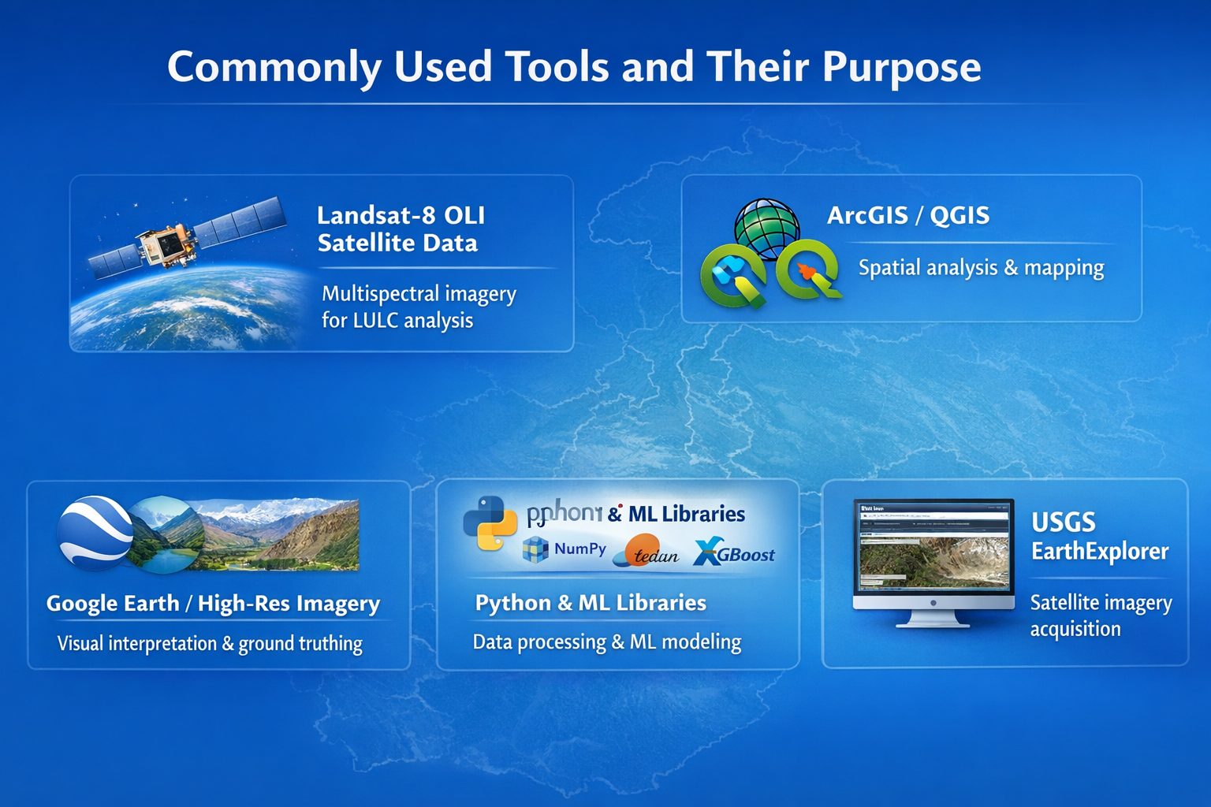
Commonly used Tools and there purpose
Landsat-8 OLI Satellite Data — Provides multispectral imagery for extracting land-use and vegetation information over Diamer District.
ArcGIS / QGIS — Used for spatial data handling, visualization, mapping, and preparation of training and validation samples.
Google Earth / High-Resolution Imagery — Supports visual interpretation and ground-truth sample collection.
Python (NumPy, Pandas, Scikit-learn, XGBoost, Matplotlib) — Used for data preprocessing, feature extraction, model training, accuracy assessment, and visualization.
USGS EarthExplorer Platform — Used to download Landsat satellite imagery.

Slide 6
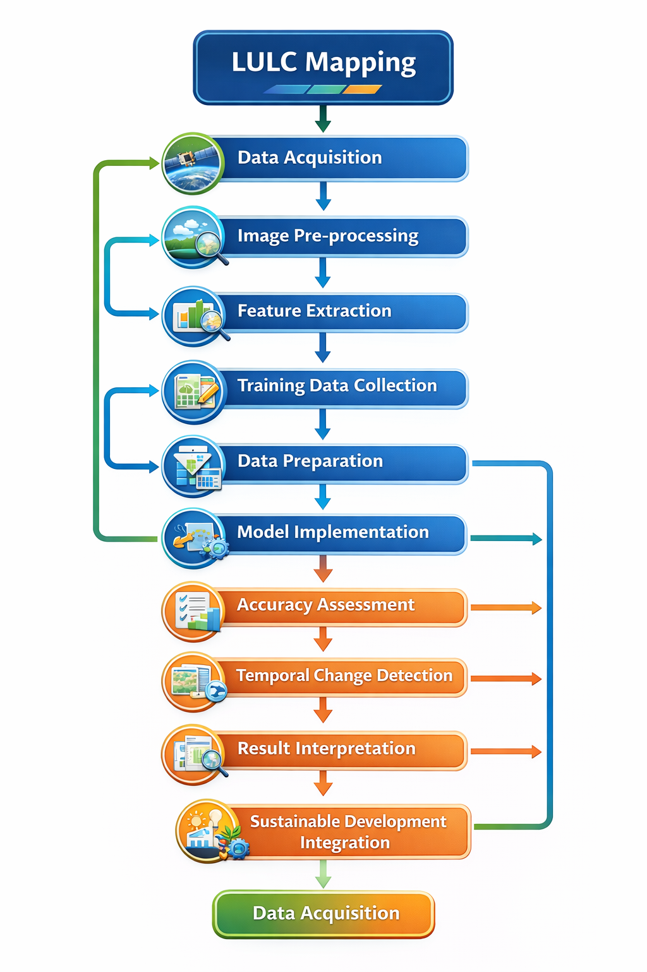
Metholodogy
Data Acquisition
Image Pre-processing
Feature Extraction
Training Data Collection
Data Preparation
Model Implementation
Accuracy Assessment
Temporal Change Detection
Result Interpretation
Sustainable Development Integration

Slide 7
Data Acquisition
Landsat-8 OLI Level-2 surface reflectance data were used.
Cloud-free images from the growing season were selected.
Data were downloaded from the USGS EarthExplorer platform.
Multi-temporal imagery was used for change analysis.

Slide 8
Image Pre-processing
Atmospheric, radiometric, and geometric corrections were applied.
Cloud masking was performed to remove atmospheric interference.
Invalid and noisy pixels were removed.
Images were aligned to a uniform projection and resolution.

Slide 9
Feature Extraction
Visible, NIR, and SWIR spectral bands were extracted.
NDVI was calculated to enhance vegetation discrimination.
NDVI values range from −1 to +1 indicating vegetation density.

Slide 10
Training Data Collection
Ground truth samples were collected using visual interpretation.
High-resolution imagery and ancillary data supported labeling.
Major classes: barren land, vegetation, water, built-up areas.

Slide 11
Data Preparation
Pixel values were extracted into a structured CSV dataset.
Features were standardized for numerical consistency.
Data were split into 70% training and 30% testing using stratified sampling.

Slide 12
Model Implementation
Three supervised models were applied: SVM, Random Forest, and XGBoost.
SVM handled high-dimensional spectral data using kernel functions.
Random Forest combined multiple decision trees for robust classification.
XGBoost modeled complex non-linear relationships with boosting.

Slide 13
Accuracy Assessment
Confusion matrices were generated for each model.
Overall accuracy, producer’s accuracy, user’s accuracy, and kappa coefficient were calculated.
Models were evaluated for robustness and generalization.

Slide 14
Temporal Change Detection
Multi-date classified maps were compared.
Post-classification comparison was used to detect changes.
Vegetation and land-cover dynamics were analyzed over time.

Slide 15
Result Interpretation
Ensemble models (RF and XGBoost) outperformed SVM.
XGBoost achieved the highest accuracy and robustness.
Results confirmed suitability of ML for mountainous LULC mapping

Slide 16
Sustainable Development Integration
Results support SDG-9 (Industry, Innovation, Infrastructure).
Results support SDG-13 (Climate Action).
Findings assist evidence-based environmental management.

Slide 17
Data Source
Satellite Data: Landsat-8 OLI Level-2 Surface Reflectance imagery
Data Provider: U.S. Geological Survey (USGS)
Platform: USGS EarthExplorer
Temporal Coverage: Cloud-free images acquired during the growing season
Spatial Resolution: 30 meters
Study Area: Diamer District, Gilgit-Baltistan

Slide 18
Data Collection Process
Multispectral Landsat images were downloaded from USGS EarthExplorer.
Cloud-free scenes were selected to minimize atmospheric and snow effects.
Atmospheric correction and cloud masking were applied.
Pixel-wise spectral values were extracted at training sample locations.
Ground truth samples were generated using visual interpretation of high-resolution imagery and ancillary data.
The dataset was divided into training (70%) and testing (30%) sets using stratified sampling.

Slide 19
Data Structure and Attributes
Data Format: Tabular (CSV) dataset derived from raster imagery
Each Record Represents: One pixel / sample point
Input Attributes (Features):
Visible bands (Blue, Green, Red)
Near-Infrared (NIR) band
Shortwave Infrared (SWIR) bands
NDVI (Normalized Difference Vegetation Index)
Target Attribute (Label):
Land Use / Land Cover class (e.g., Barren Land, Vegetation, Water, Built-up)
Data Type: Structured, labeled, and multiclass
Purpose: Suitable for supervised machine learning classification (SVM, RF, XGBoost)

Slide 20
EDA steps and findings
EDA Steps
Inspected the dataset structure, data types, and class labels.
Checked for missing, null, and invalid values in spectral bands.
Analyzed the distribution of each spectral band and NDVI values.
Examined class-wise sample distribution to identify class imbalance.
Visualized feature relationships and separability between LULC classes.
Identified outliers and extreme values caused by clouds, snow, or noise

Slide 21
EDA Findings
The dataset is structured, labeled, and suitable for supervised classification.
No major missing values were present after preprocessing and cloud masking.
Class imbalance exists, with barren land and snow-dominated areas having more samples than others.
NDVI effectively separates vegetation from non-vegetation classes.
Some spectral overlap exists between barren land and built-up areas.
Feature standardization is necessary for distance-based models like SVM.

Slide 22
Preprocessing Steps
Preprocessing Steps
Atmospheric correction
Cloud masking and removal of invalid pixels
Radiometric and geometric correction
Image alignment to a common projection and resolution
Feature standardization (scaling of spectral values)

Slide 23
Why These Steps Are Used
Atmospheric correction removes atmospheric noise and improves spectral accuracy.
Cloud masking eliminates cloud and shadow contamination from the imagery.
Radiometric and geometric correction ensure spatial and spectral consistency across images.
Image alignment allows accurate pixel-by-pixel comparison in multi-temporal analysis.
Feature standardization improves model performance, especially for distance-based classifiers like SVM.

Slide 24
Final Applied Analysis Steps
Train supervised ML models (SVM, Random Forest, XGBoost) on the prepared dataset.
Generate classified LULC maps for the study area.
Evaluate model performance using confusion matrices and accuracy metrics.
Compare model results to identify the best-performing classifier.
Perform temporal change detection using multi-date classified maps.
Interpret results in relation to environmental and sustainability objectives.

Slide 25
Why These Steps Are Applied
To learn spectral–land-cover relationships from labeled training data.
To produce spatial LULC maps for visualization and analysis.
To quantitatively assess classification reliability.
To select the most accurate and robust model for mountainous terrain.
To detect changes in vegetation and land use over time.
To support evidence-based environmental and sustainable development planning.

Slide 26
Results and Discussion
All three machine learning models — SVM, Random Forest, and XGBoost — performed very well in classifying LULC in Diamer District, with overall accuracy exceeding 99.7%.
Ensemble-based models (Random Forest and XGBoost) consistently outperformed SVM due to their stronger ability to model non-linear relationships and handle class imbalance.
XGBoost achieved the highest accuracy and robustness, making it the most reliable model for LULC classification in complex mountainous terrain.

Slide 27
Results and Discussion
Random Forest showed stable and consistent performance with minimal overfitting, while SVM showed slightly lower performance in separating spectrally similar classes.
The integration of spectral bands and NDVI significantly improved vegetation and barren land separability.
The results confirm that advanced machine learning techniques provide more accurate and reliable LULC maps than traditional classifiers in heterogeneous alpine environments.

Slide 28
Conclusion
This study demonstrates that supervised machine learning techniques are highly effective for LULC mapping in complex mountainous environments like Diamer District.
All applied models achieved very high accuracy (>99.7%), confirming the suitability of ML for spatial classification tasks.
Ensemble models outperformed SVM, with XGBoost emerging as the most accurate and robust classifier.

Slide 29
Conclusion
The integration of multispectral bands and NDVI significantly improved land-cover separability.
The proposed framework provides a reliable and reproducible approach for environmental monitoring, land-use planning, and sustainable development in alpine regions.

